Slide 1
PING PONG
PROJECT BY:
K.V.S.VIKRAMADITYA
B.AKASH
M.ASAD

Slide 2
INTRODUCTION:
Ping pong game is a simple 2 dimensional game developed by using C language and OpenGL library.
It is one of the simple most popular and well known game.
All these graphics are implemented using standard open glut library.
Pong is one of the earliest arcade video games. It is a table tennis sports game featuring simple two dimensional graphics.
Pong quickly became a success and was the first commercially successful video game, which helped to establish the video game industry along with the first home console.

Slide 3
DIRECTIONS AND RULES TO PLAY:
Player One moves the Down Paddle by using Left Arrow Key to move Left and Right Arrow Key to move Right.
Player Two moves the Top Paddle by using ‘a’ Key to move Left and ‘d’ Key to move Right.
If a player misses the ball the other player gains a point.
The game has the time limit of one minute.
After time completes the player with high score wins.

Slide 4
HEADER FILES:
# include <windows.h>
#include <stdlib.h>
#include <stdio.h>
# include <GL/glut.h>
#define NO_COLLISION_DETECTED 0
#define BOTTOM_PADDLE_COLLISION 1
#define TOP_PADDLE_COLLISION 2
#define NOT_OUT_OF_BOUNDS 0
#define OUT_OF_BOUNDS_TOP 1
#define OUT_OF_BOUNDS_BOTTOM 2
#define OUT_OF_BOUNDS_LEFT 3
#define OUT_OF_BOUNDS_RIGHT 4

Slide 5
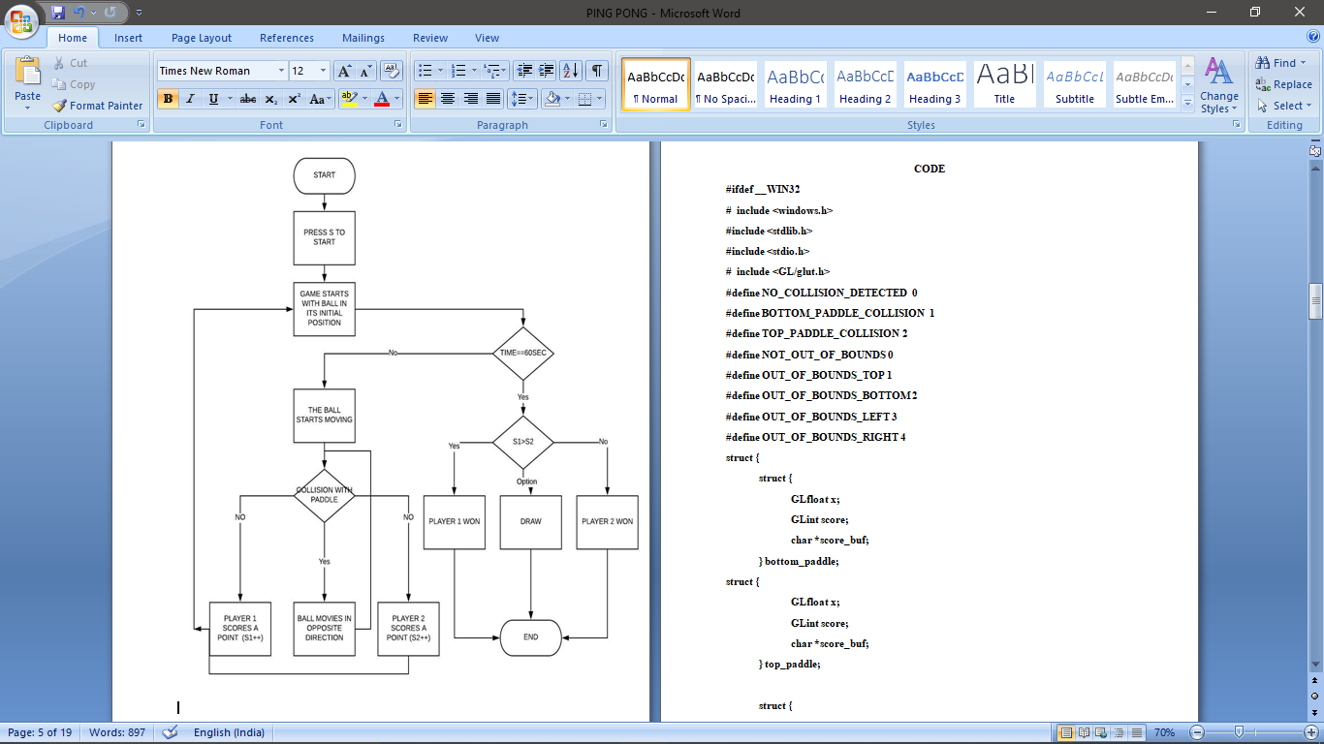
FLOW CHART:

Slide 6
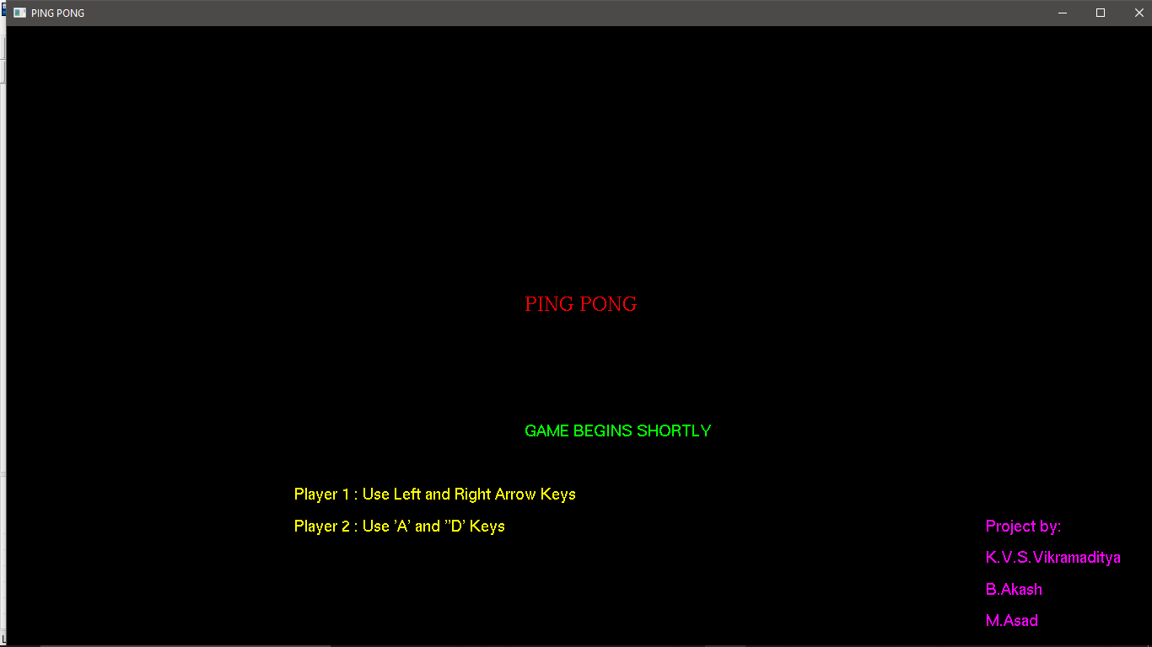
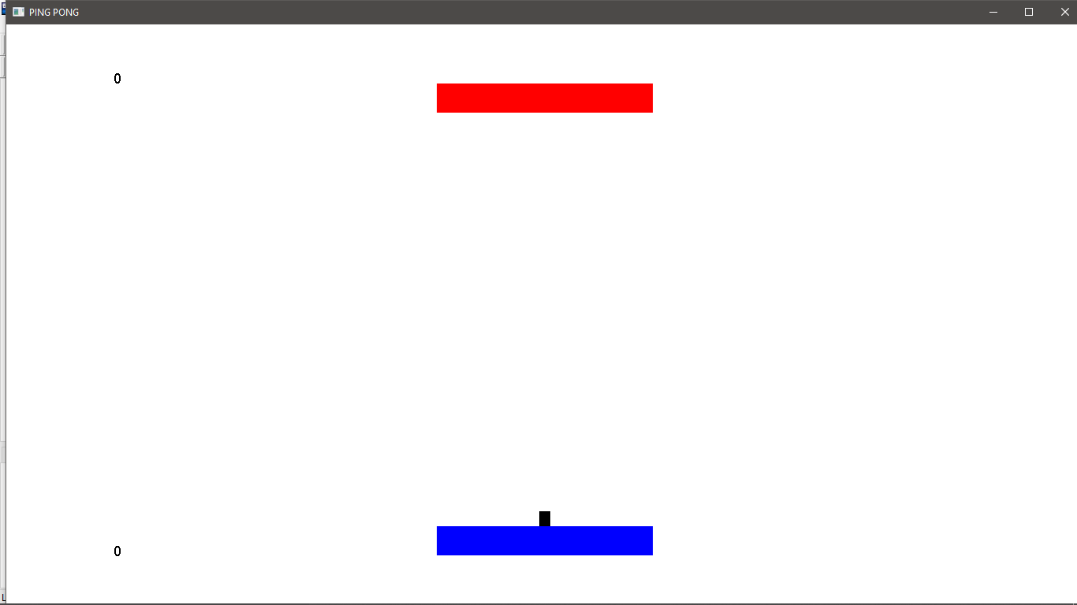
SCREEN SHOTS:
Start screen
Start of game.

Slide 7
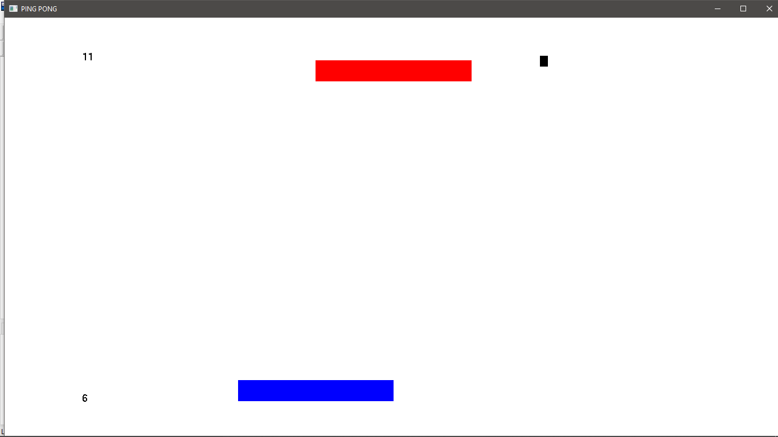
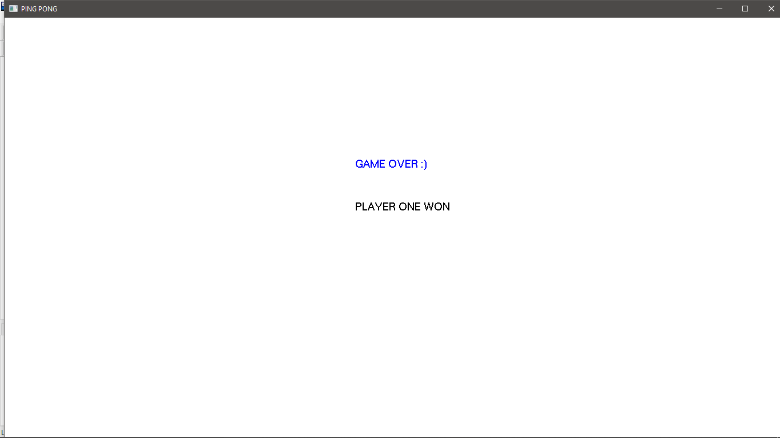
SCREEN SHOTS:
Player 2 missing the ball.
End Screen

Slide 8
REFERENCES:
https://www.opengl.org/resources/libraries/glut
https://www.khronos.org/registry/OpenGL-Refpages/gl2.1/xhtml/glOrtho.xml

Slide 9
THANK YOU.

